Slide 1

Explainable Fuzzy Logic – towards XFC
CSP-300
AirHeads
Justin Ortega Kyle Nguyen Andrew Jeske

Slide 2
Agenda
Recap
LLM
Actor-Critic
Sugeno / Neuro-Fuzzy
Scenarios
Timeline and Future Work

Slide 3
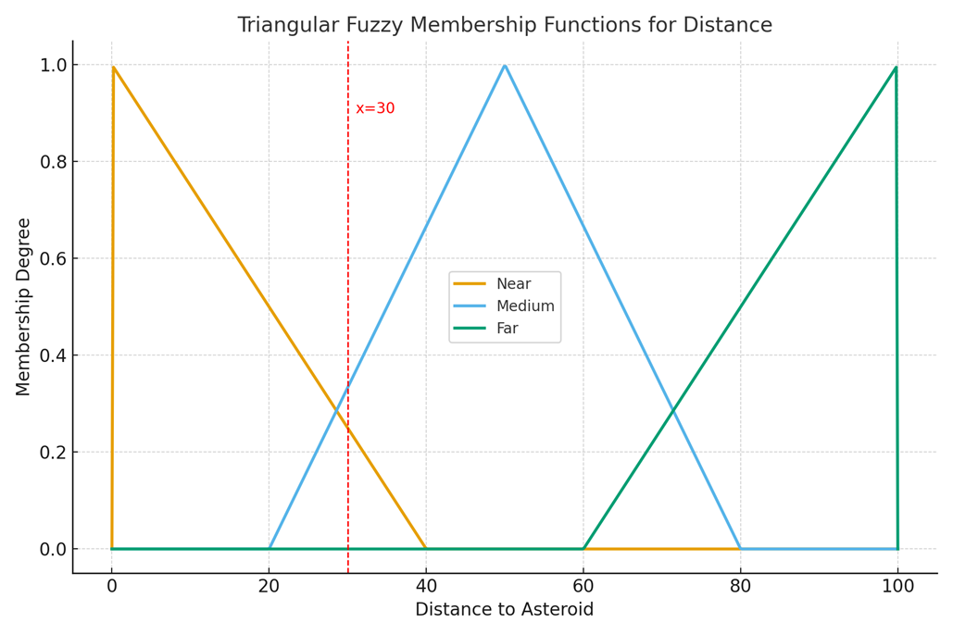

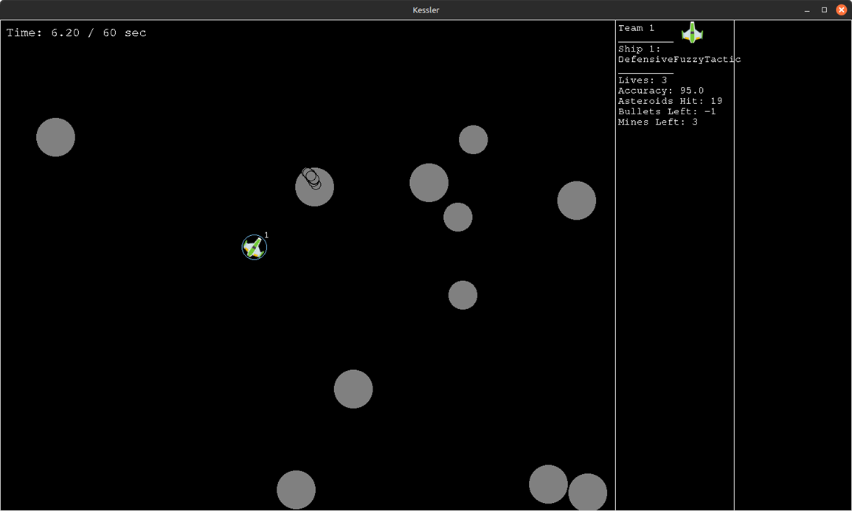
Recap
Introduced the Explainable Fuzzy Challenge(XFC) and its goal of building transparent AI controllers for the Kessler Game
Researched fuzzy logic fundamentals: how it models uncertainty using degrees of truth and fuzzy sets

Slide 4
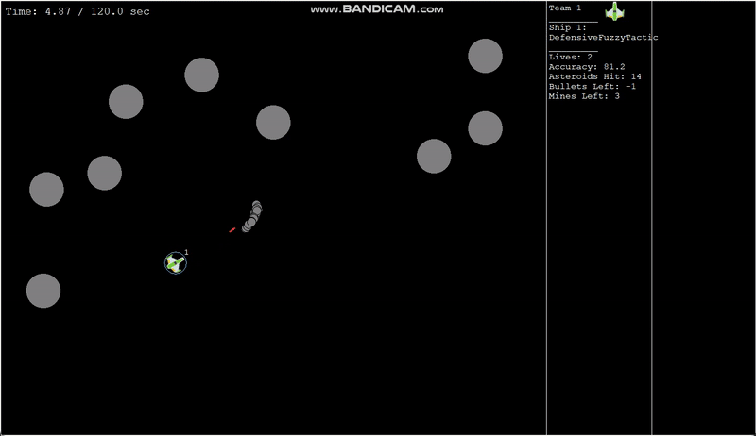
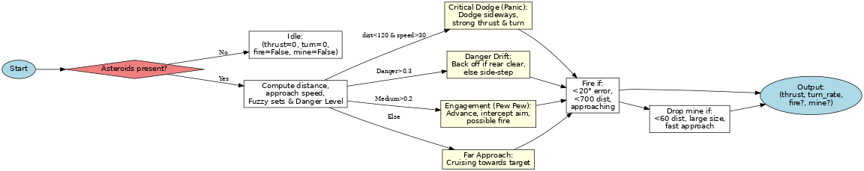
Kyle's Controller
Recap
Inputs: distance, approach speed → fuzzified into sets (Near, Medium, etc.).
Danger Level: combines distance + speed.
Modes:
Critical Dodge: close & fast → sidestep hard.
Danger Drift: danger high → back off if clear, else dodge sideways.
Engagement: medium range → aim, thrust, fire if aligned.
Far Approach: cruising until closer.
Extra rules: Fire conditions, Mine deployment.

Slide 5
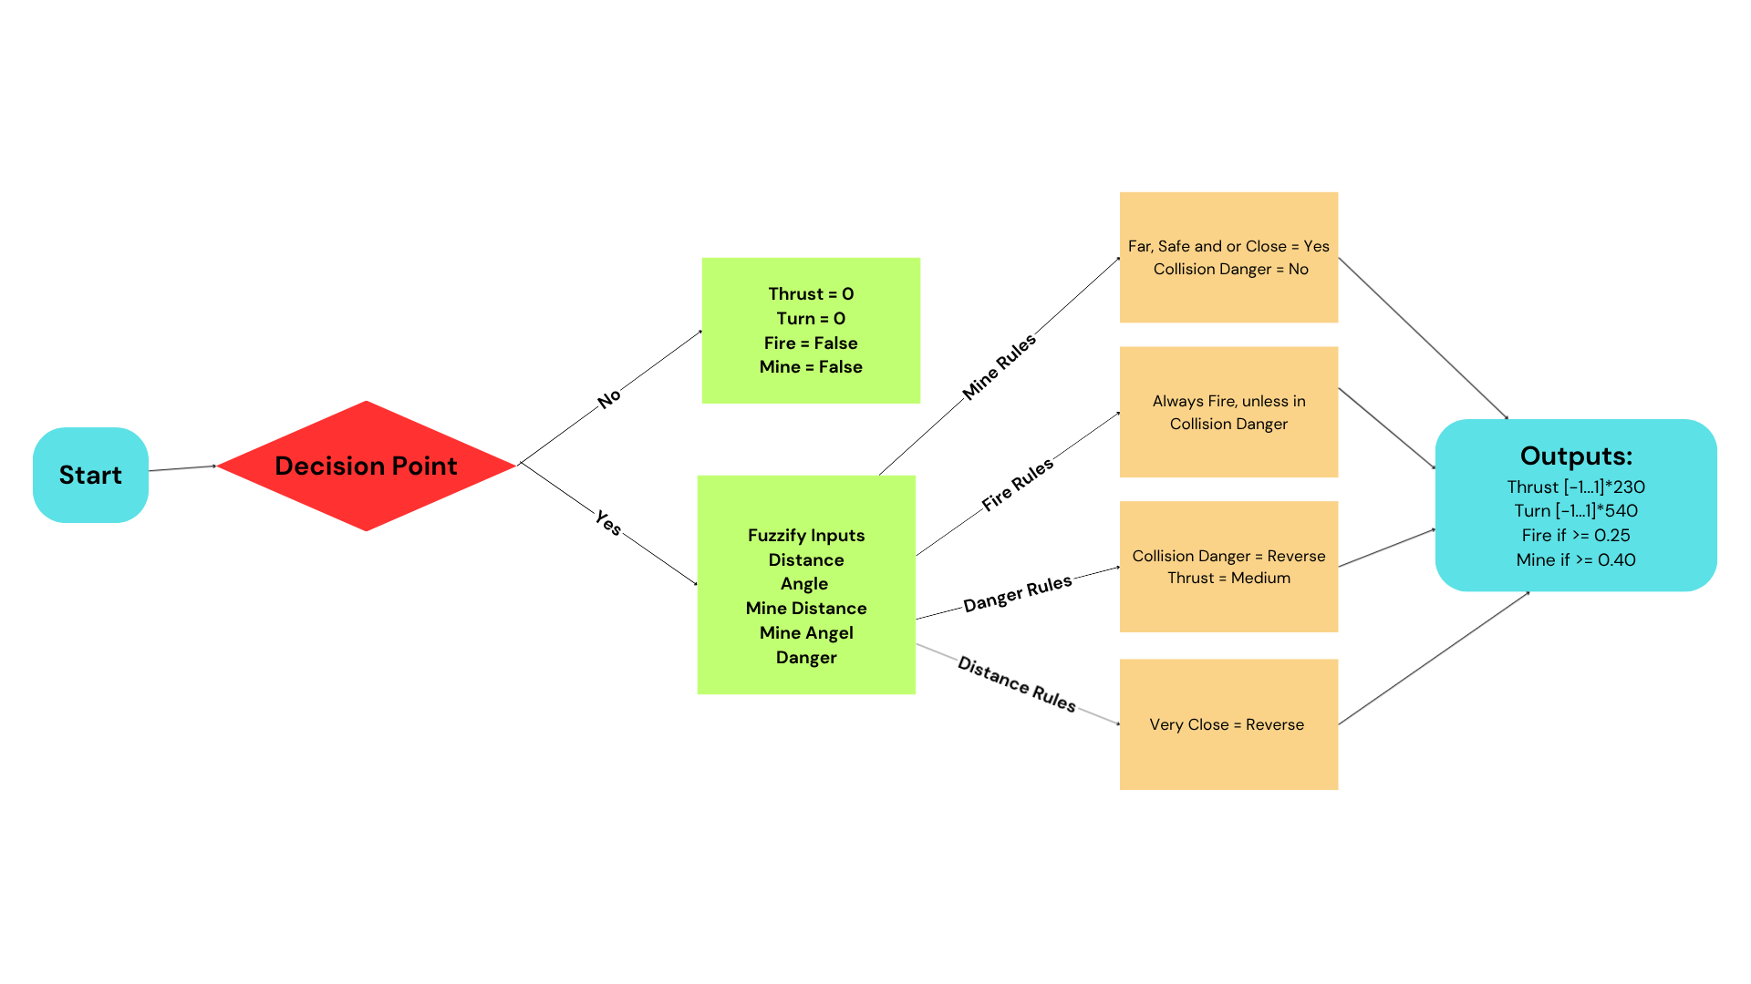

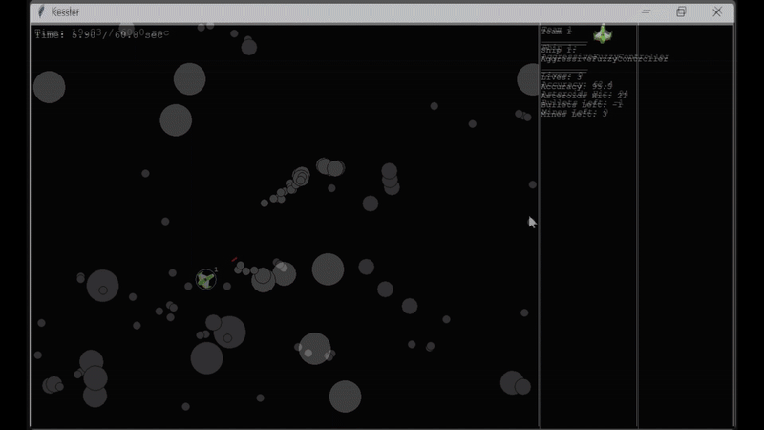
Andrew's Controller
Recap
Inputs: Distance, relative speed, angle, danger level
Aggression Level: Offensive: always seeks targets, fires when aligned, only disengages if danger is imminent
Safe Mode: Near but slow = safe, only dangerous is approaching fast
Modes:
Aggressive Thrust : Far = high thrust, Near/Close = medium thrust, Very close= reverse
Turning: Asteroids → minimal adjustments, Mines very near → hard dodge away, Collision imminent → hard turn opposite away
Engagement: Fires when asteroid ahead and safe. Stops when asteroid very close or mine very close.
Mine Deployment: Don't drop if another mine is near, or in danger. Otherwise, drop mine.

Slide 6


Recap
Introduced LLMs (Large Language Models) as a future step to help generate different possible rules for the Fuzzy System
Discussed RL (Reinforcement Learning) giving the Fuzzy System the ability to learn and adapt

Slide 7
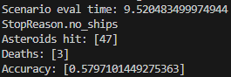
LLM
Why?
Generate different possible rulesets
There are roughly 1024 combination
Measurement

Slide 8
LLM System Flow Chart
Run the Game with Current Ruleset
Game Ends with Current Ruleset
Store Results into CSV File
Call API to Generate New Ruleset
Replace Current Ruleset with New Ruleset
Store New Ruleset in TXT File
Run the Game with New Ruleset

Slide 9
Actor-Critic
What?
A RL method that combines Policy and Value based approaches
Policy-Based Method- The agent learns directly through a policy
Aka. It's action
Value-Based Method- The agent learns through a value function
Typically a Map with known Rewards and it calculates which step returns the highest value
Why?
Handles continuous actions
Able to act out real-world controls
More stable learning
Critic reduces variance of updates
Learns faster
Feedback after every step, not just after episodes

Slide 10
Hybrid fuzzy controller with a trainable neuro-fuzzy model

Slide 11
Overall Pipeline
Play the game with a good handwritten controller → collect and log data(features + actions).
Train a Sugeno neuro-fuzzy network on that CSV.
Load the trained model in the runtime controller and let it output actions.

Slide 12
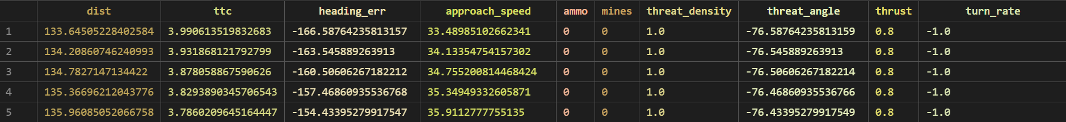
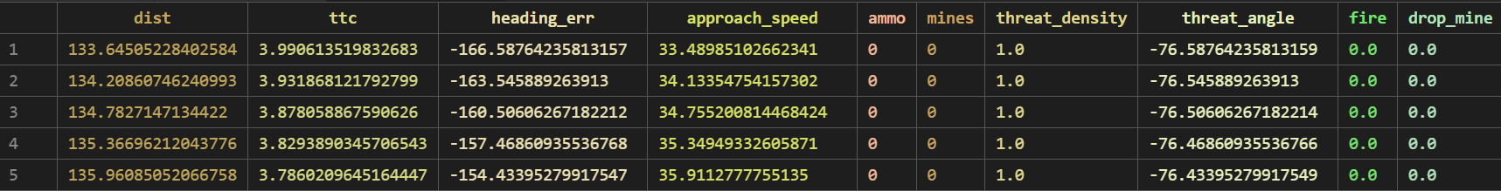
Data Logging
What one timestep looks at (the ‘inputs’):
distance to closest asteroid
time-to-collision (ttc)
heading error (how off from pointing at the threat)
approach speed
ammo, mines
threat density (how crowded)
threat angle

Slide 13
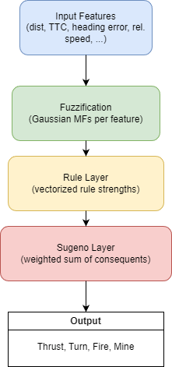
Network Architecture (Sugeno / Neuro-Fuzzy)
Input Layer: Game context features (distance, time-to-collision, heading error, etc.)
Fuzzification Layer: Applies Gaussian membership functions (learns μ, σ) → fuzzy degrees of membership.
Rule Layer: Combines fuzzy sets via product (AND) to compute rule firing strengths.
Sugeno Layer: Generates weighted sum of linear consequents (learns rule coefficients).
Main Layers:
Output Layer: Aggregates all rule outputs into final crisp control signals — thrust, turn_rate, fire, mine.

Slide 14
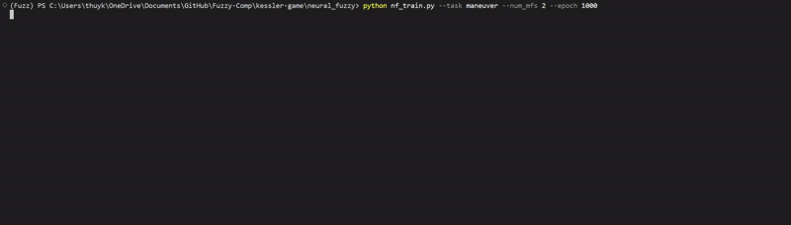
Training
Collect data:
Run game with handwritten/hybrid controller → log (inputs, actions) to CSV.
Build model:
Sugeno / neuro-fuzzy network (Gaussians → rules → Sugeno).
Supervised learning:
Feed inputs from CSV, predict actions.
Compute loss:
MSE between model output and teacher action.
Backprop + optimizer:
Update MF centers/sigmas and rule consequents.
Save bundle:
Export trained model + feature order for inference.

Slide 15
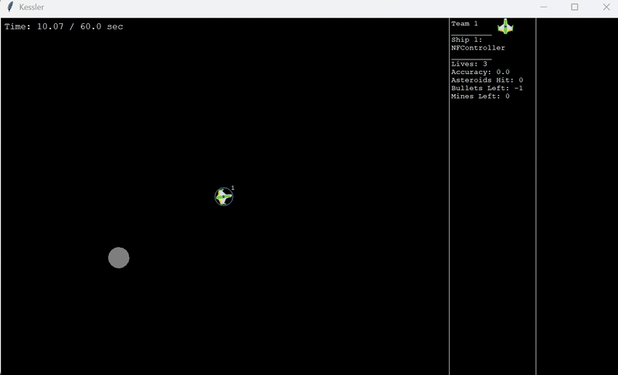
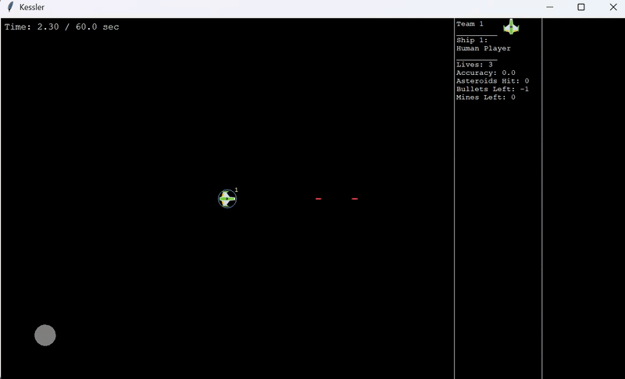
Inference
Inference
Load trained model:
Load saved bundle so it knowsthe weights + feature order.
Rebuild context each frame:
Read current game state →compute same features as intraining (dist, TTC, headingerror, rel. speed, …).
Forward pass:
Feed features → neuro-fuzzymodel → get actions (thrust,turn_rate, fire/mine).
Post-process:
Clamp/normalize actions toship limits so the game acceptsthem.
Log outputs:
Write model actions to CSV fordebugging / comparison.

Slide 16

Scenarios

Slide 17
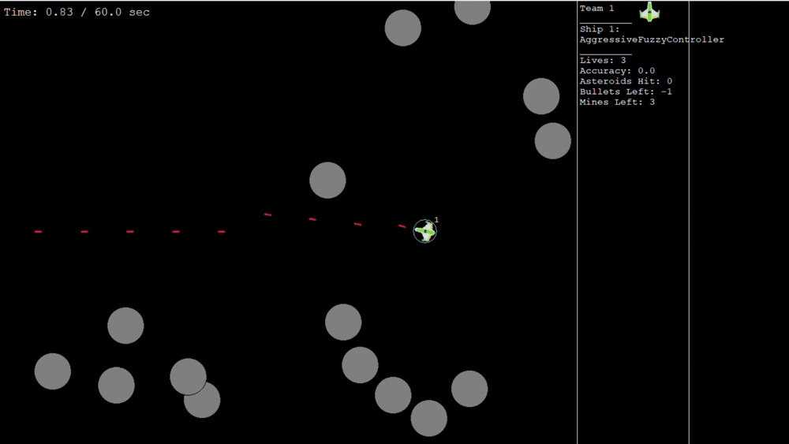
Stock Scenario

Slide 18
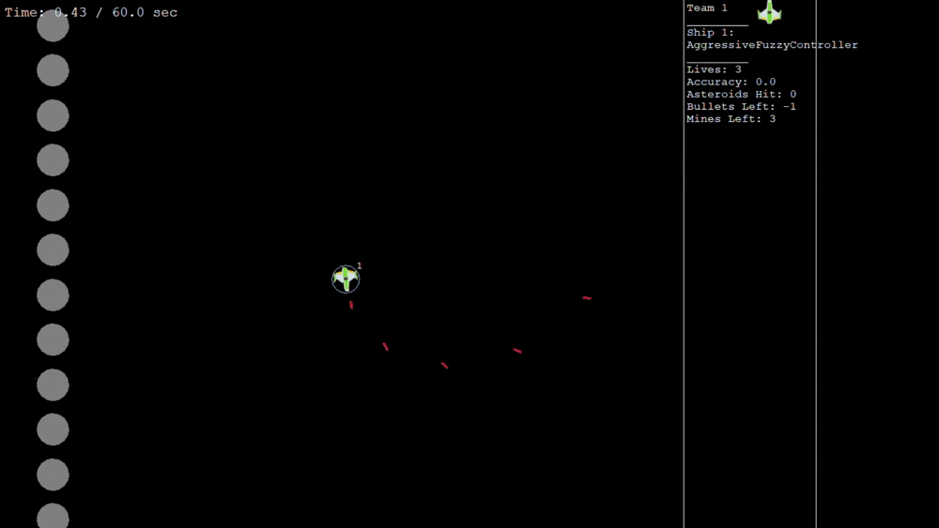
Vertical Wall

Slide 19
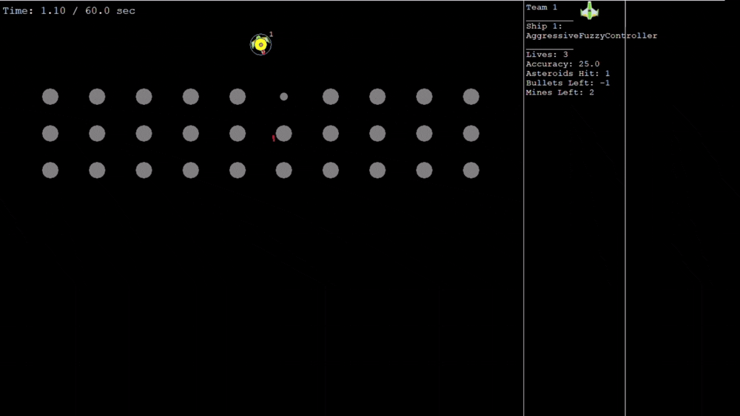
Asteroid Rain

Slide 20
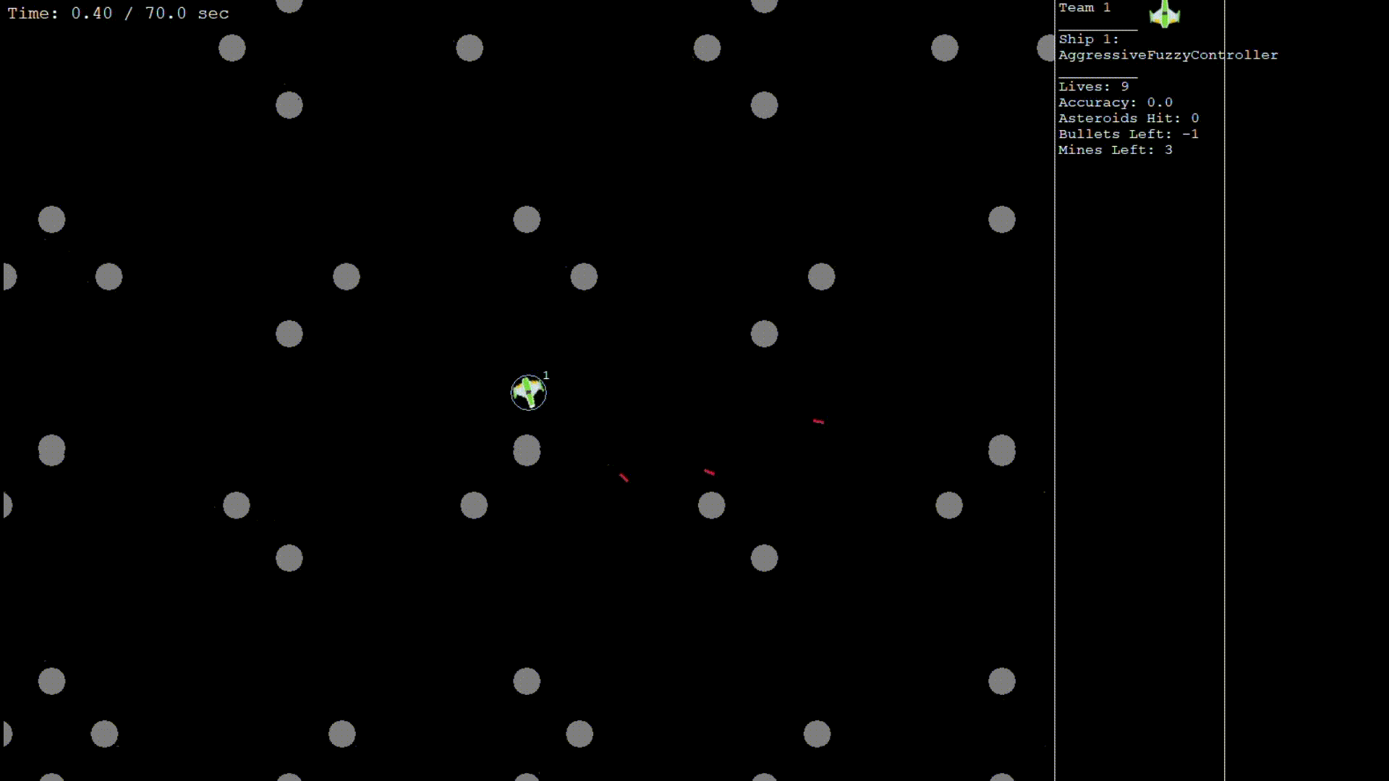
Crossing Lanes

Slide 21
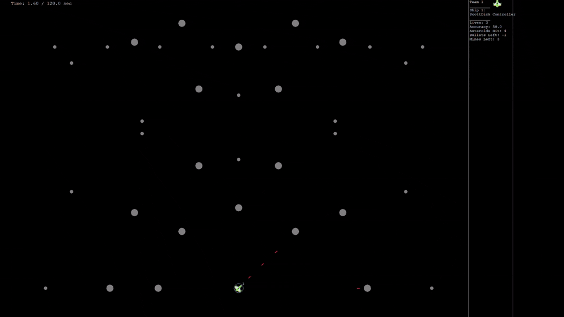
Sniper Practice

Slide 22
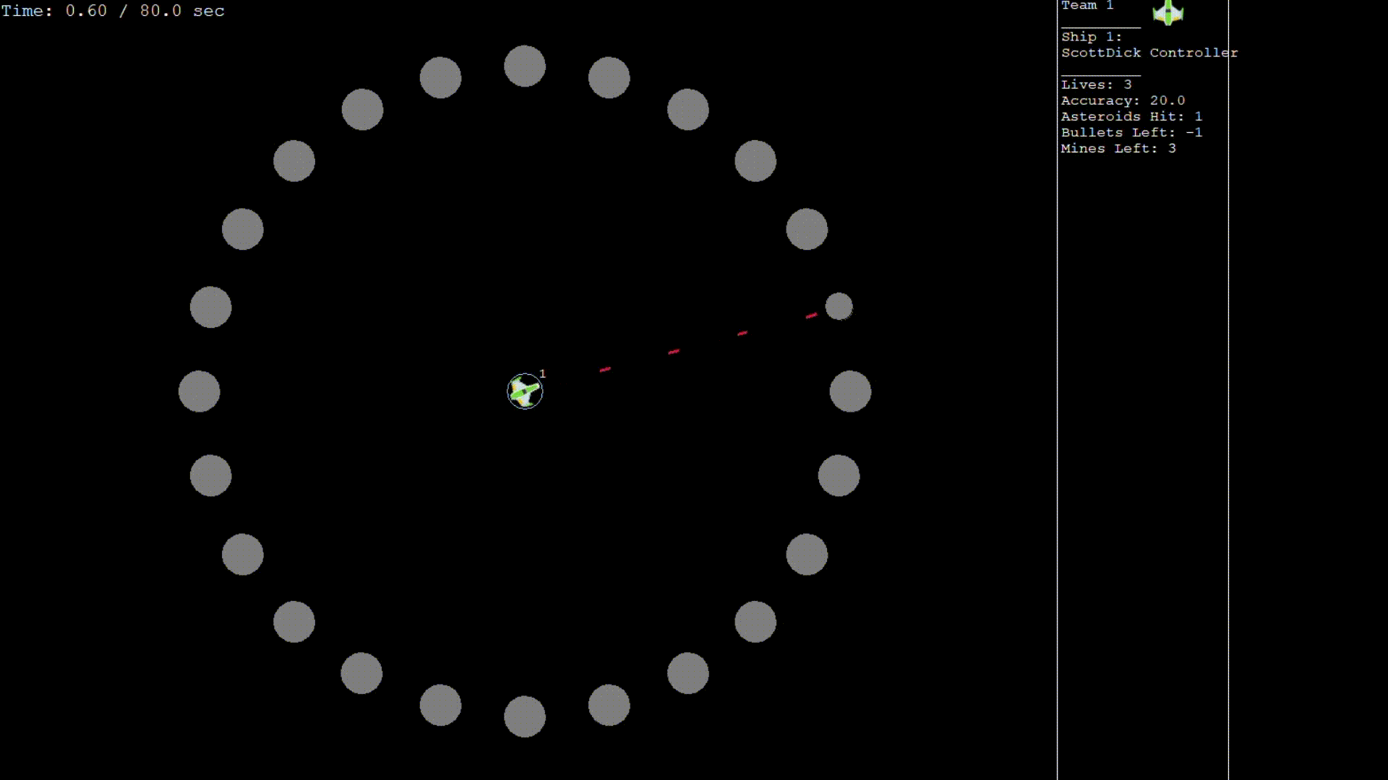
Donut Ring

Slide 23
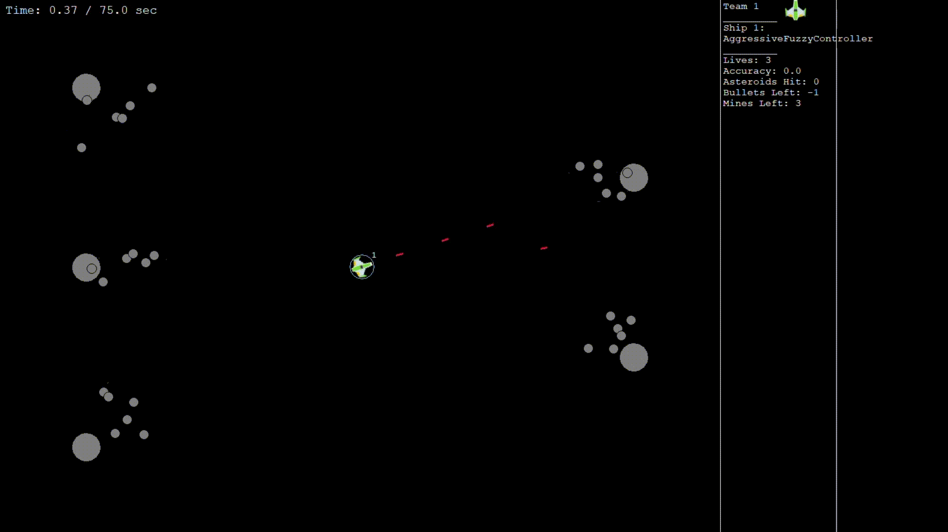
Giant Asteroids with Tiny Asteroids

Slide 24
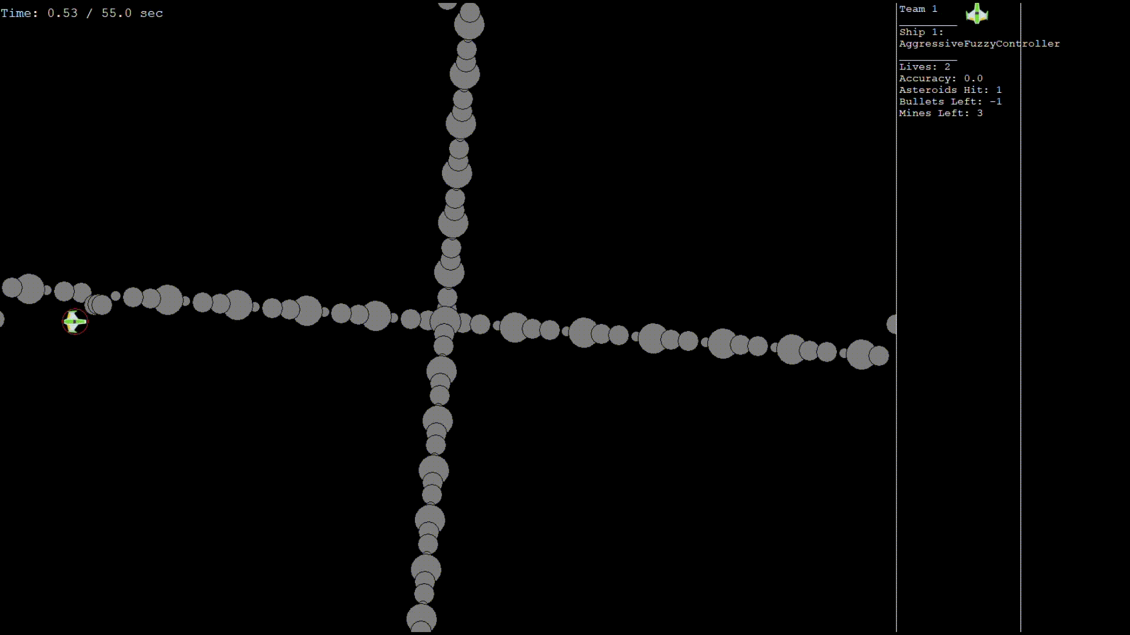
Rotating Cross

Slide 25
Timeline and Future Work
M2
LLM Integration
M3
Implement Actor-Critic Reinforcement Learning Method
Next Semester
Train the Agents and Compare performance amongst each agent
Network implementation
Scenario Design
Optimizing network architecture, tuning and training

Slide 26
References
“What Are the Policy-Based Methods? - Hugging Face Deep RL Course.” Huggingface.co, 2024, huggingface.co/learn/deep-rl-course/en/unit4/what-are-policy-based-methods.
ApX Machine Learning. “Comparing Value-Based and Policy-Based Methods.” Apxml.com, ApX Machine Learning, 2025, apxml.com/courses/intro-to-reinforcement-learning/chapter-8-introduction-policy-gradient-methods/comparing-value-policy-based-methods.
Reinforcement learning. Coursera. (n.d.). https://www.coursera.org/specializations/reinforcement-learning
Chanen, A. (2023, August 20). What I learned from Bloomberg’s experience of building their own LLM. LinkedIn. https://www.linkedin.com/pulse/what-i-learned-from-bloombergs-experience-building-own-chanen-phd
Welcome to XFC 2025!. Explanable Fuzzy Challenge. (n.d.). https://xfuzzycomp.github.io/XFC
Jang, J.-S. R., Sun, C.-T., & Mizutani, E. (1997). Neuro-Fuzzy and Soft Computing: A Computational Approach to Learning and Machine Intelligence. Prentice Hall.
Millo, C., Bravo, C., Covelli, S., Pavoni, E., Petranich, E., Contin, M., De Nobili, M., Crosera, M., Otero Sutti, B., das Mercês Silva, C., & de Santis Braga, E. (2021). Metal Binding and Sources of Humic Substances in Recent Sediments from the Cananéia-Iguape Estuarine-Lagoon Complex (South-Eastern Brazil). Applied Sciences, 11(18), 8466. https://doi.org/10.3390/app11188466

